Slide 1

SCM DASHBOARD

Slide 2
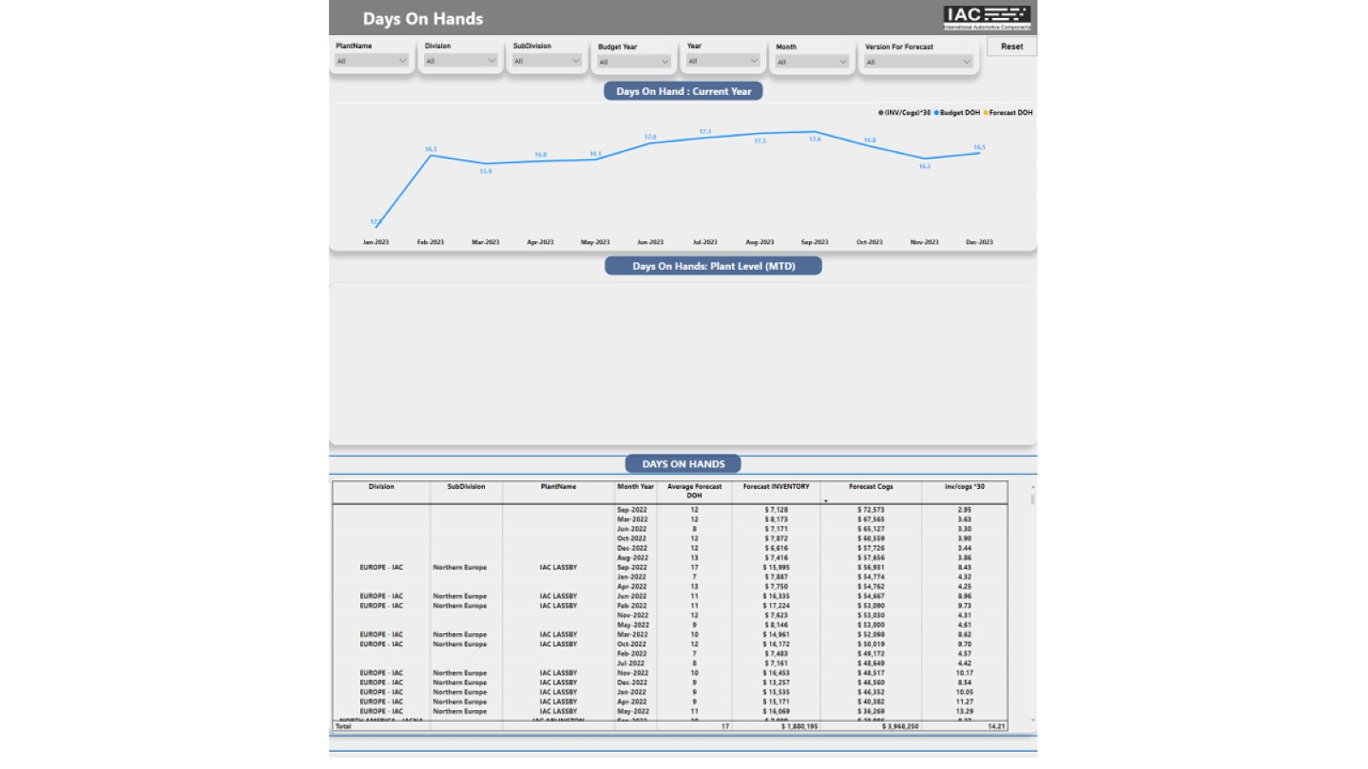
HFM_DOH

Slide 3
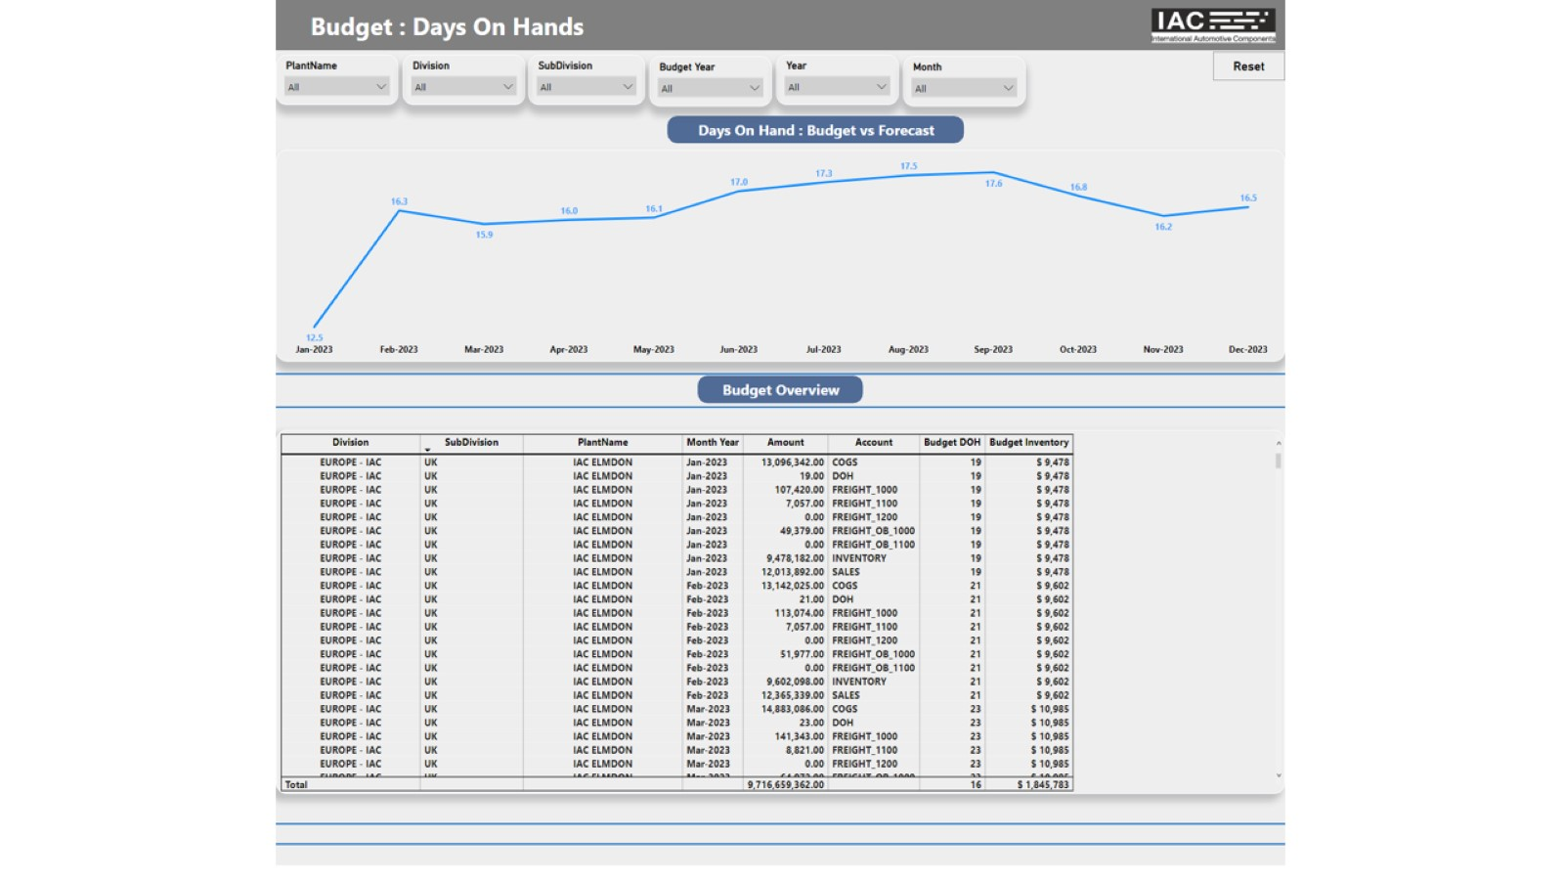
Budget

Slide 4
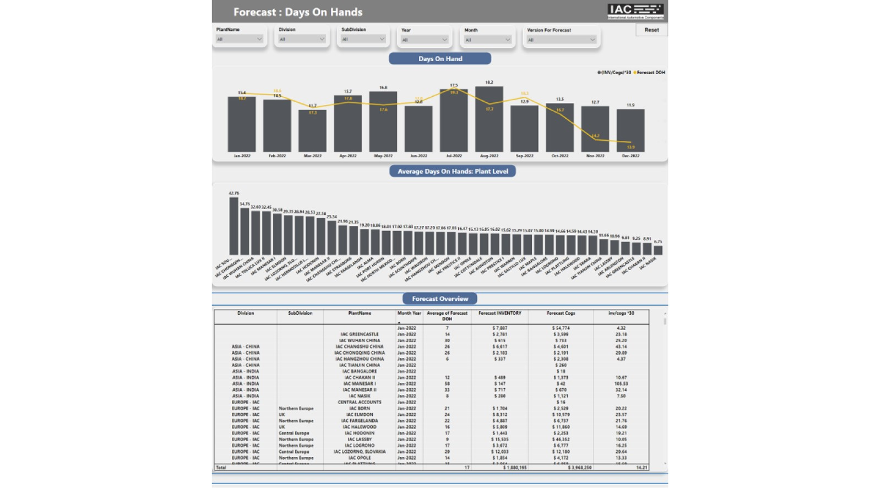
Forecast

Slide 5
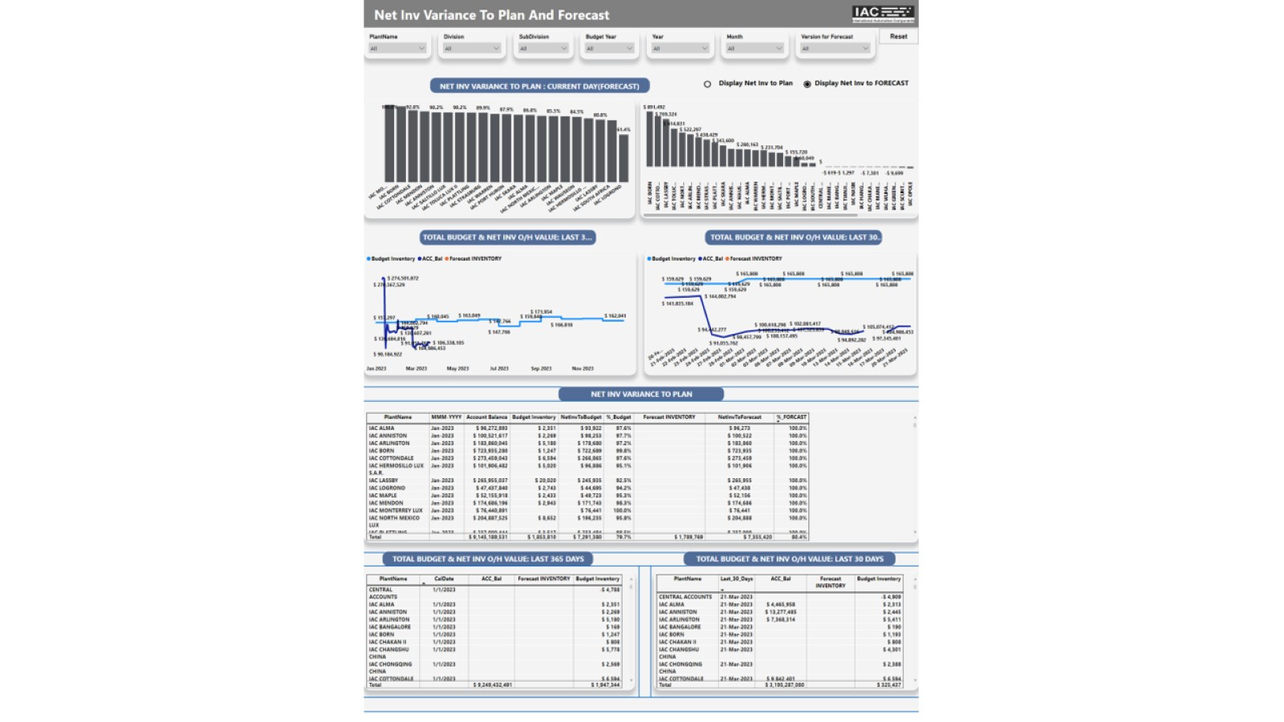
HFM_ Net Inv To Plan with %

Slide 6
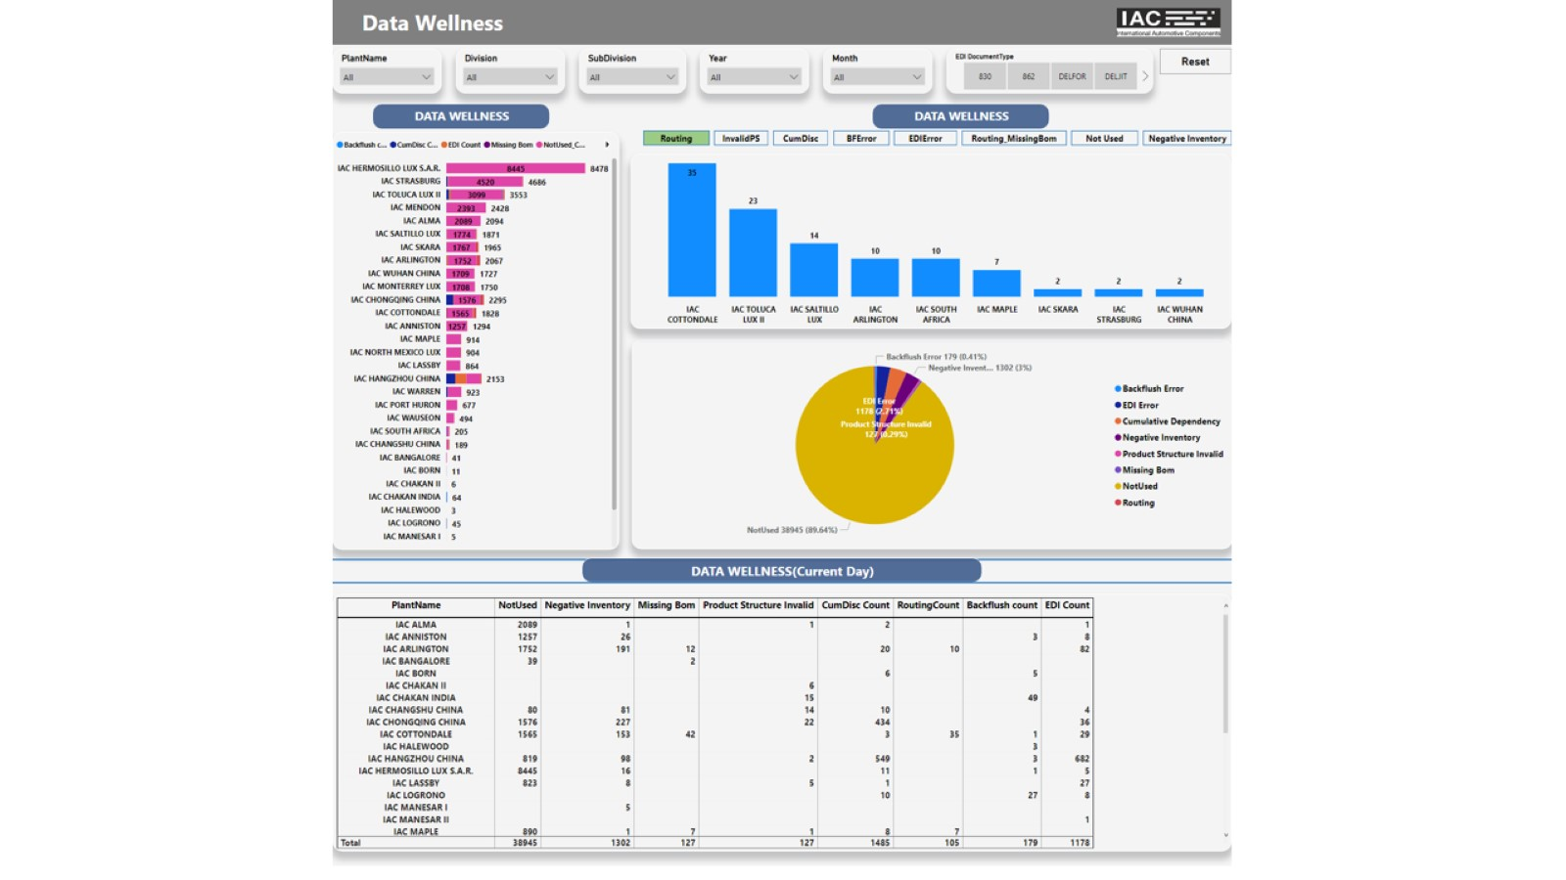
Data Wellness Overview

Slide 7
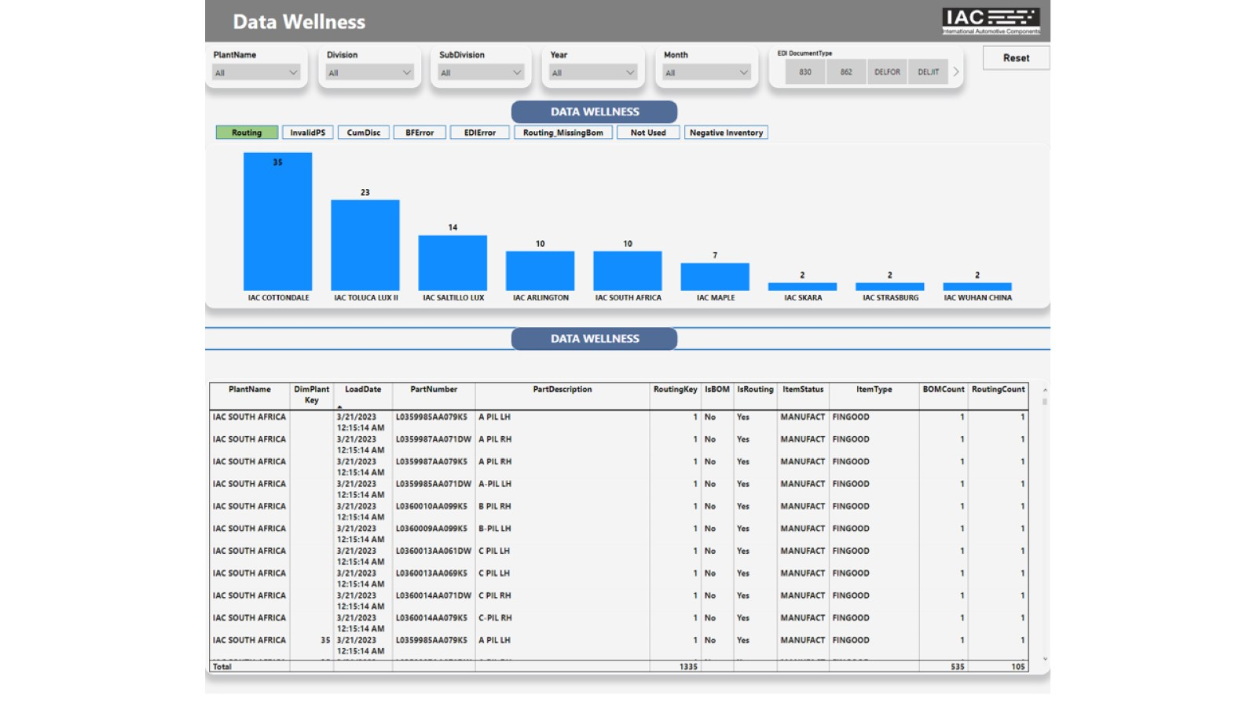
Data Wellness - Detail

Slide 8
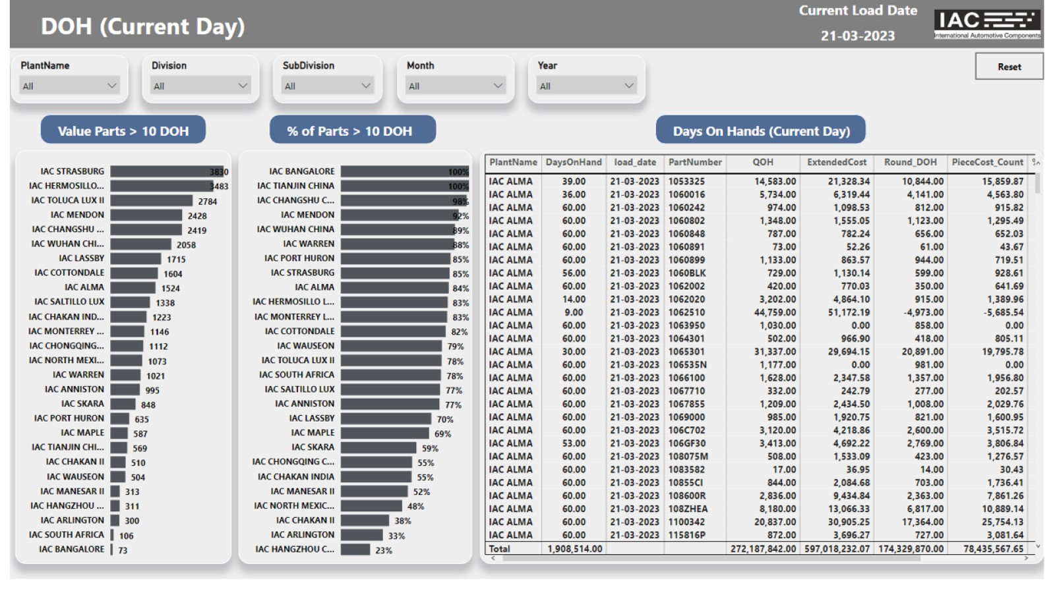
AllPlants_DOH

Slide 9
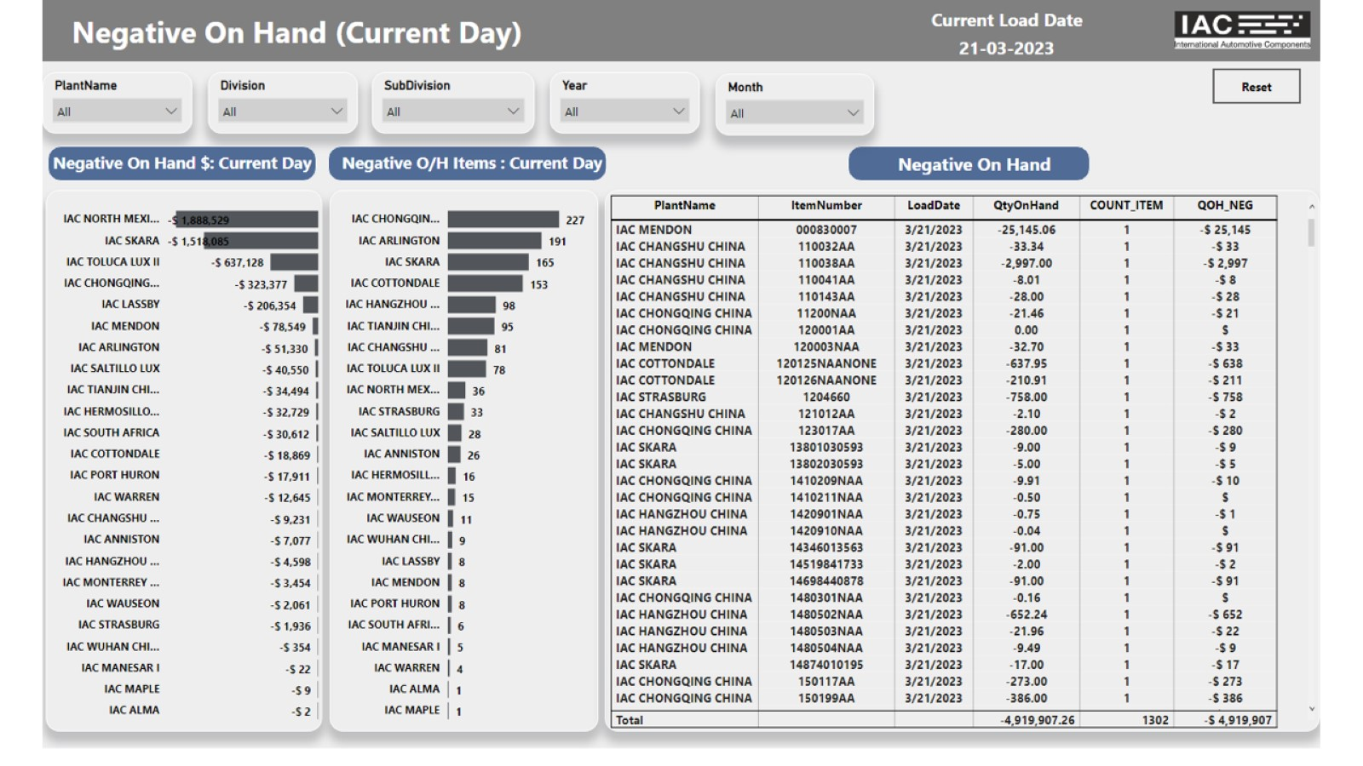
AllPlants_NEG_QOH

Slide 10
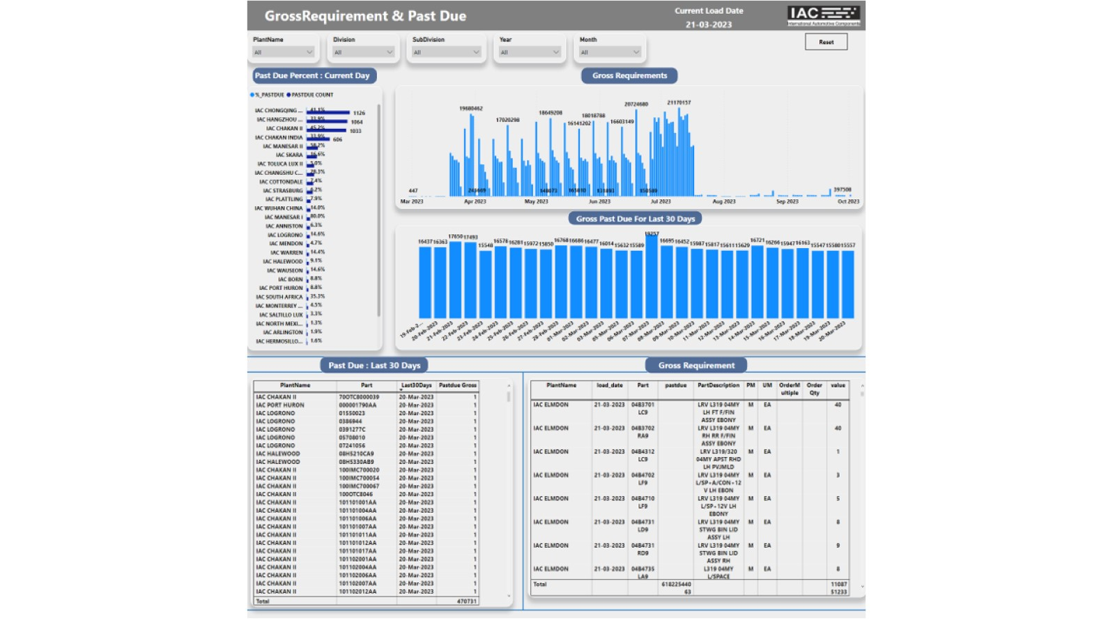
AllPlants_GROSS PastDue

Slide 11
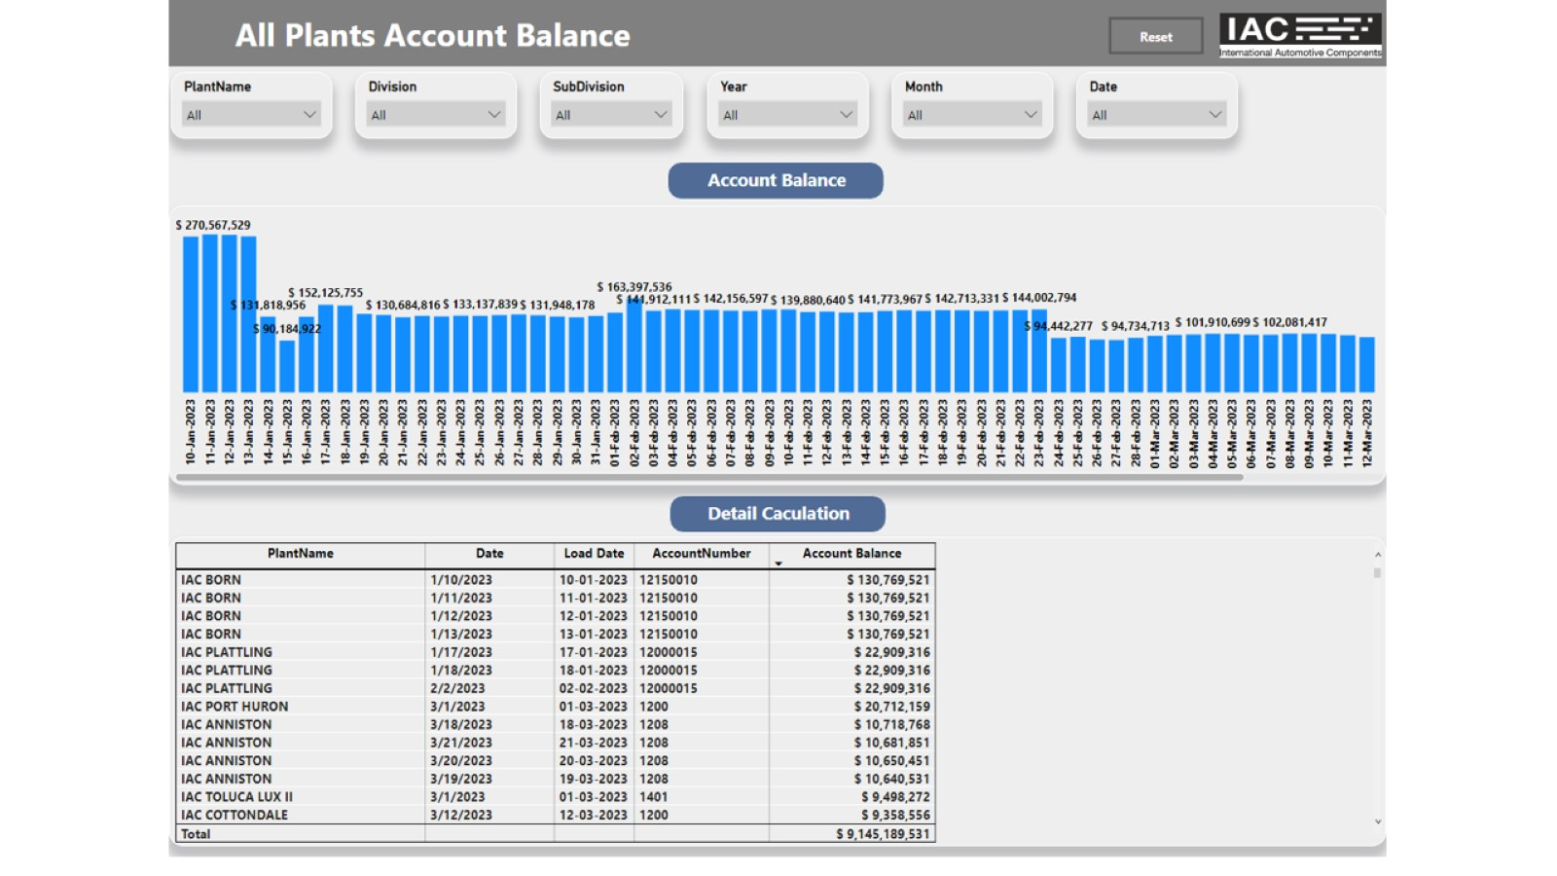
All Plants Account_Balance

